Slide 1
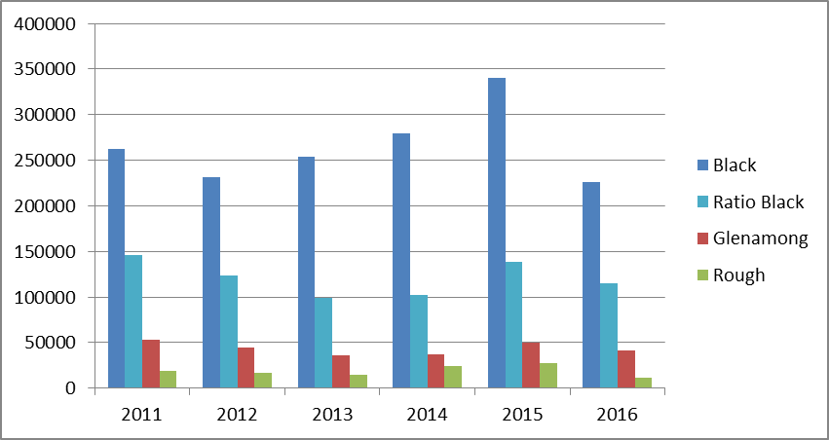
Method Used in River Colour Paper (Brian) Drainage area ratio method - Hirsch (1979) Discharge (y) = Area(y)/Area(z) X Discharge (z) so for Burrishoole discharge (black) = Area (black) / Area (glenamong) X discharge (glenamong) actual calculation = (48.3/17.5)*discharge (Glenamong)
Y axis = cumulative l/s⁻¹d⁻¹ discharge
Graph shows the overestimation of discharge from the Black River

Slide 2
Sean’s method calculates lake input using lake output, so the whole catchment is included.
One way to check accuracy of discharge volumes is to use the area ratio method from Sean’s lake input to estimate Glenamong discharge – and then compare with actual calculated Glenamong discharge.
discharge (Glenamong) = Area (Glenamong) / Area (Burrishoole) X discharge (Burrishoole)
If it is accurate – we could then subtract the actual Glenamong discharge from Sean’s lake input which would:
Always give the calculated water balance lake input
The timing would correspond with the Glenamong River

